Slide 1
Any node is the path from the root to the node is called
a.Successor node
b.Ancestor node
c.Internal node
d.None of the above

Slide 2
State true of false. i) A node is a parent if it has successor nodes. ii) A node is child node if out degree is one.
a.True, True
b.True, False
c.False, True
d.False, False

Slide 3
Adjacency matrix of all graphs are symmetric.
a.False
b.True
c.May be
d.Can't say

Slide 4
…………………. Is a directed tree in which out degree of each node is less than or equal to two.
a.Unary tree
b.Binary tree
c.Trinary tree
d.Both B and C

Slide 5
State true or false. i) An empty tree is also a binary tree. ii) In strictly binary tree, the out-degree of every node is either o or 2.
a.True, False
b.False, True
c.True, True
d.False, False

Slide 6
For the adjacency matrix of a directed graph the row sum is the _________ degree and the column sum is the ________ degree.
a.in, out
b.out, in
c.in, total
d.total, out

Slide 7
When inorder traversing a tree resulted E A C K F H D B G;
the preorder traversal would return
a.FAEKCDBHG
b.FAEKCDHGB
c.EAFKHDCBG
d.FEAKDCHBG

Slide 8
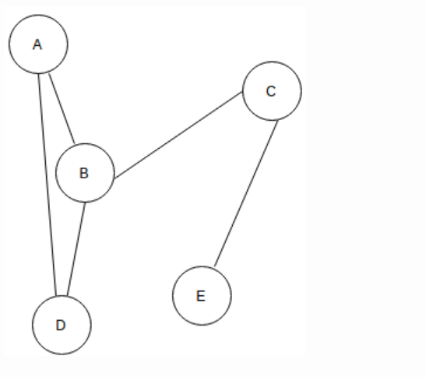
In the given graph identify the cut vertices.
a.B and E
b.C and D
c.A and E
d.C and B

Slide 9
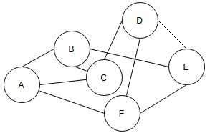
The given Graph is regular.
a.True
b.False
c.May be
d.Can't say

Slide 10
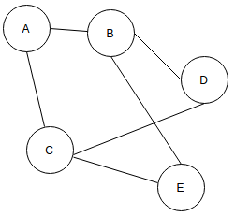
For the given graph(G), which of the following statements is true?
a.G is a complete graph
b.G is not a connected graph
c.The vertex connectivity of the graph is 2
d.The edge connectivity of the graph is 1

Slide 11
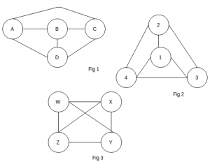
Which of the following graphs are isomorphic to each other?
a.fig 1 and fig 2
b.fig 2 and fig 3
c.fig 1 and fig 3
d.fig 1, fig 2 and fig 3

Slide 12
A binary tree whose every node has either zero or two children is called
a.Complete binary tree
b.Binary search tree
c.perfect binary tree
d.None of above

Slide 13
When representing any algebraic expression E which uses only binary operations in a 2-tree,
a.the variable in E will appear as external nodes and operations in internal nodes
b.the operations in E will appear as external nodes and variables in internal nodes
c.the variables and operations in E will appear only in internal nodes
d.the variables and operations in E will appear only in external nodes

Slide 14
The post order traversal of a binary tree is DEBFCA. Find out the pre order traversal
a.ABFCDE
b.ADBFEC
c.ABDECF
d.ABDCEF

Slide 15
In a binary tree, certain null entries are replaced by special pointers which point to nodes higher in the tree for efficiency. These special pointers are called
a.Leaf
b.Branch
c.Path
d.thread

Slide 16
The in order traversal of tree will yield a sorted listing of elements of tree in
a.Binary trees
b.Binary search trees
c.Heaps
d.None of above

Slide 17
In a Heap tree
a.Values in a node is greater than every value in left sub tree and smaller than right sub tree
b.Values in a node is greater than every value in children of it
c.Both of above conditions applies
d.None of above conditions applies

Slide 18
In order to get the information stored in a Binary Search Tree in the descending order, one should traverse it in which of the following order?
a.left, root, right
b.root, left, right
c.right, root, left
d.right, left, root

Slide 19
A complete graph can have ...............
a.n^2 spanning trees
b. n^(n-2) spanning trees
c.n^(n+1) spanning trees
d.n^n spanning trees

Slide 20
Graph traversal is different from a tree traversal, because:
a.trees are not connected
b.graphs may have loops
c.trees have root
d.None of these

Slide 21
The number of edges in a simple, n-vertex, complete graph is
a.n*(n-2)
b.n*(n-1)
c.n*(n-1)/2
d.n*(n-1)*(n-2)

Slide 22
Graphs are represented using ............
a.Adjacency tree
b.Adjacency linked list
c.Adjacency graph
d.Adjacency queue

Slide 23
The spanning tree of connected graph with 10 vertices contains ..............
a.9 edges
b.11 edges
c.10 edges
d. 9 vertices
*****

Slide 24
If locality is a concern, you can use ................ to traverse the graph.
a.Breadth First Search
b.Depth First Search
c.Either BFS or DFS
d.None of these

Slide 25
Which of the following algorithms solves the all-pair shortest path problem?
a.Floyd's algorithm
b.Prim's algorithm
c.Dijkstra's algorithm
d.Warshall's algorithm

Slide 26
Which of the following is useful in traversing a given graph by breadth first search?
a.Set
b.List
c.Stacks
d.Queue

Slide 27
What about recursion is true in comparison with iteration?
A - very expensive in terms of memory.
B - low performance.
C - every recursive program can be written with iteration too.
D - all of the above are true!

Slide 28
Recursion uses more memory space than iteration because
A - it uses stack instead of queue.
B - every recursive call has to be stored.
C - both A & B are true.
D - None of the above are true.

Slide 29
The minimum number of edges in a connected cyclic graph on n vertices is
a.N
b.n+1
c.n-1
d.none of the above

Slide 30
What is the number of edges present in a complete graph having n vertices?
a.(n*(n+1))/2
b.(n*(n-1))/2
c.N
d.Information given is insufficient

Slide 31
Which of the following ways can be used to represent a graph?
a.Adjacency List and Adjacency Matrix
b.Incidence Matrix
c.Adjacency List, Adjacency Matrix as well as Incidence Matrix
d.None of the mentioned

Slide 32
The number of elements in the adjacency matrix of a graph having 7 vertices is __________
a.7
b.14
c.36
d.49

Slide 33
A connected graph T without any cycles is called
a.a tree graph
b.free tree
c.a tree
d.All of above

Slide 34
In a graph if e=(u, v) means
a.u is adjacent to v but v is not adjacent to u
b.e begins at u and ends at v
c.U follows v
d.both b and c

Slide 35
For some sparse graph an adjacency list is more space efficient against an adjacency matrix.
a.True
b.False
c.May be
d.Can't say

Slide 36
In which case adjacency list is preferred in front of an adjacency matrix?
a.Dense graph
b.Sparse graph
c.Adjacency list is always preferred
d.None of the mentioned

Slide 37
On which of the following statements does the time complexity of checking if an edge exists between two particular vertices is not, depends?
A. Depends on the number of edges
B. Depends on the number of vertices
C. Is independent of both the number of edges and vertices
D. It depends on both the number of edges and vertices

Slide 38
If n elements are sorted in a binary search tree. What would be the asymptotic complexity to search a key in the tree?
O(1)
b) O(logn)
c) O(n)
d) O(nlogn)

Slide 39
If n elements are sorted in a balanced binary search tree. What would be the asymptotic complexity to search a key in the tree?
a) O(1)
b) O(logn)
c) O(n)
d) O(nlogn)

Slide 40
The minimum number of elements in a heap of height h is
2^{h+1}
2^{h}
2^{h} -1
2^{h-1}

Slide 41
The maximum number of elements in a heap of height h is
2^{h+1} -1
2^{h}
2^{h} -1
2^{h-1}

Slide 42
In which of the following tree, parent node has a key value greater than or equal to the key value of both of its children?
Binary search tree
Threaded binary tree
Complete binary tree
Max-heap

Slide 43
A binary search tree is generated by inserting in order the following integers: 50, 15, 62, 5, 20, 58, 91, 3, 8, 37, 60, 24 The number of the node in the left sub-tree and right sub-tree of the root, respectively, is a) (4, 7)
b) (7, 4)
c) (8, 3)
d) (3, 8)

Slide 44
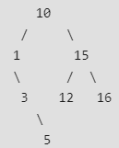
The following numbers are inserted into an empty binary search tree in the given order: 10, 1, 3, 5, 15, 12, 16. What is the height of the binary search tree (the height is the maximum distance of a leaf node from the root)?
(A) 2
(B) 3
(C) 4
(D) 6

Slide 45
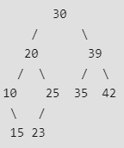
The preorder traversal sequence of a binary search tree is 30, 20, 10, 15, 25, 23, 39, 35, 42. Which one of the following is the postorder traversal sequence of the same tree?
A 10, 20, 15, 23, 25, 35, 42, 39, 30
B 15, 10, 25, 23, 20, 42, 35, 39, 30
C 15, 20, 10, 23, 25, 42, 35, 39, 30
D 15, 10, 23, 25, 20, 35, 42, 39, 30

Slide 46
A binary search tree is generated by inserting in order the following integers: 50, 15, 62, 5, 20, 58, 91, 3, 8, 37, 60, 24 The number of the node in the left sub-tree and right sub-tree of the root, respectively, is a) (4, 7)
b) (7, 4)
c) (8, 3)
d) (3, 8)

